Slide 1
Test Review & Reteach
[ 6.00 ] [ Today’s Date ] [ Instructor Name ]

Slide 2
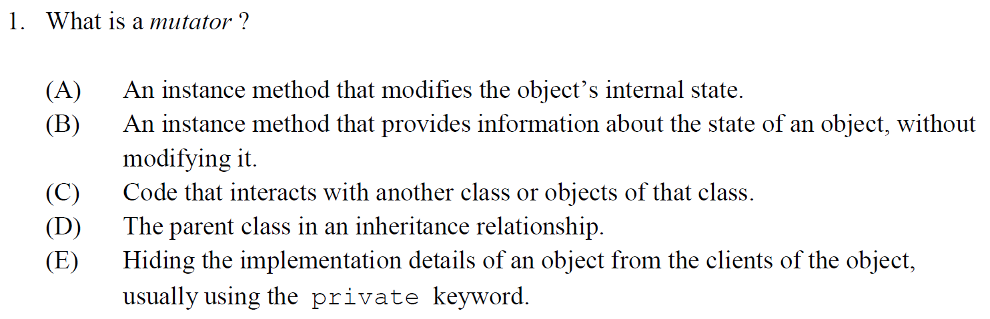

Slide 3
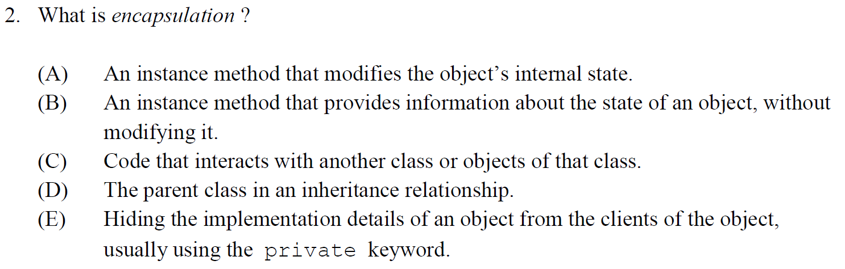

Slide 4
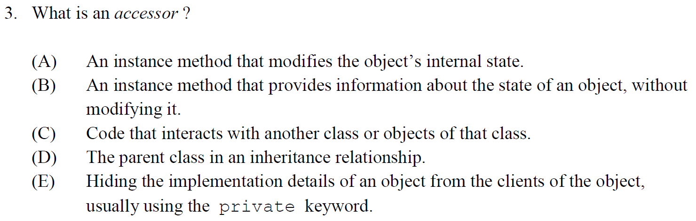

Slide 5
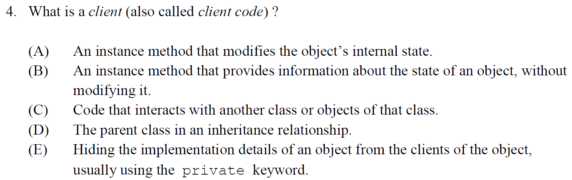

Slide 6
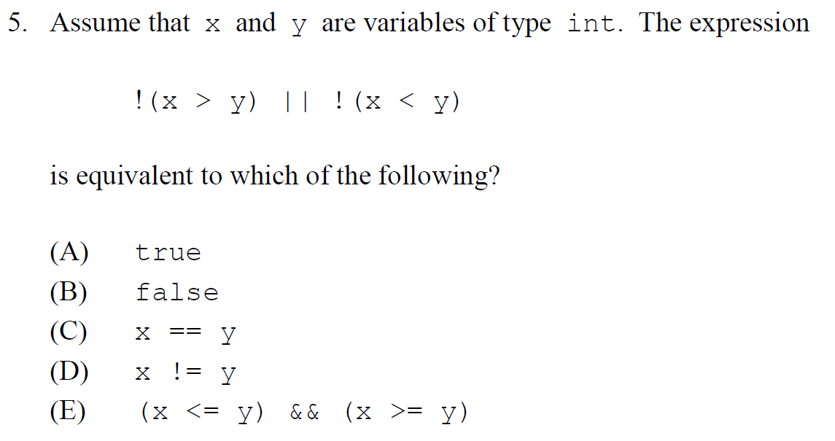

Slide 7
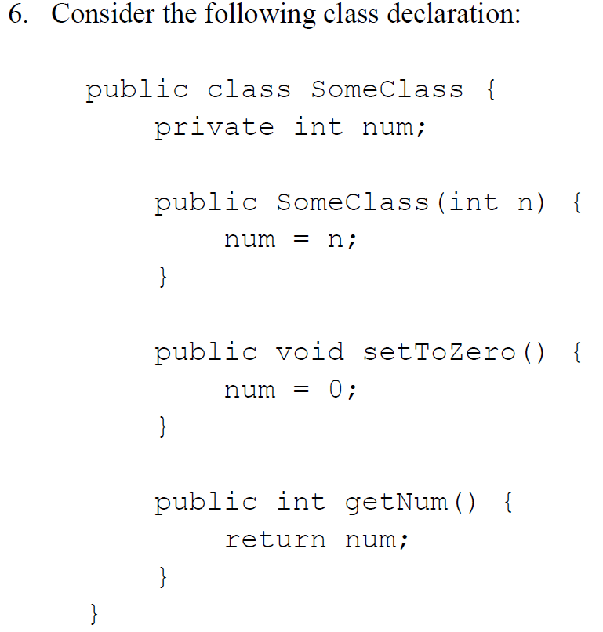
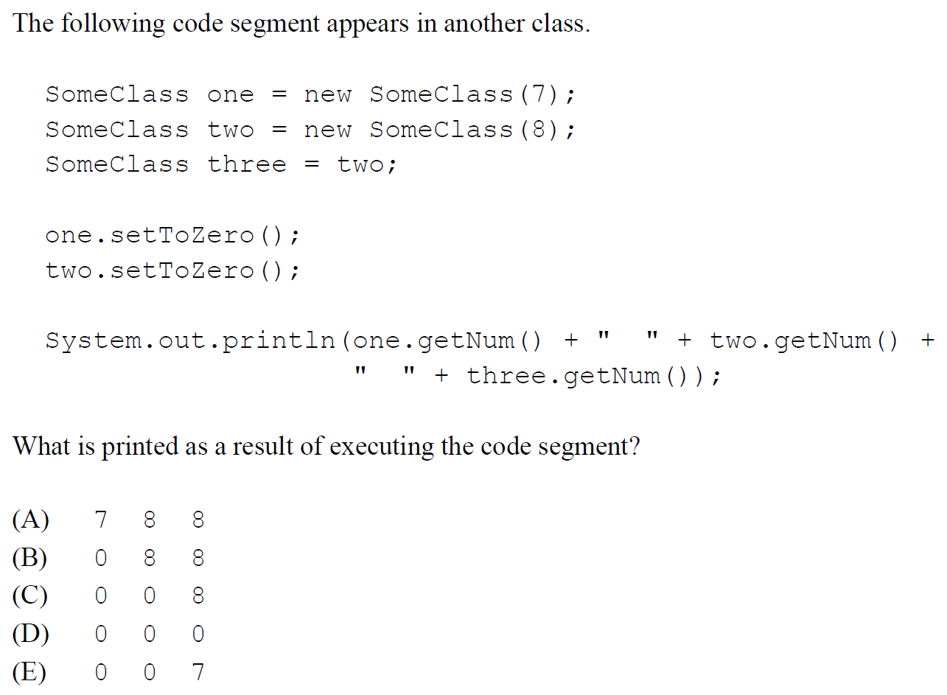

Slide 8
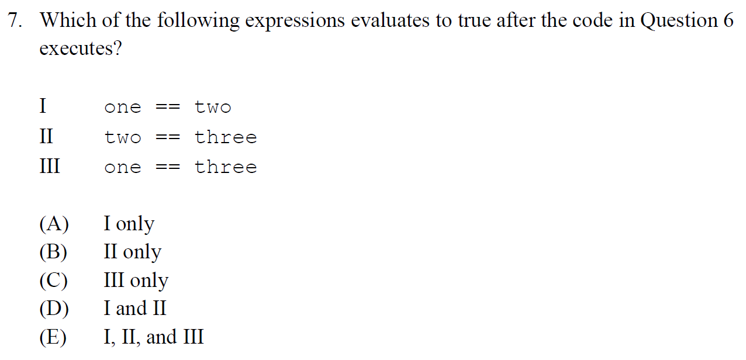

Slide 9
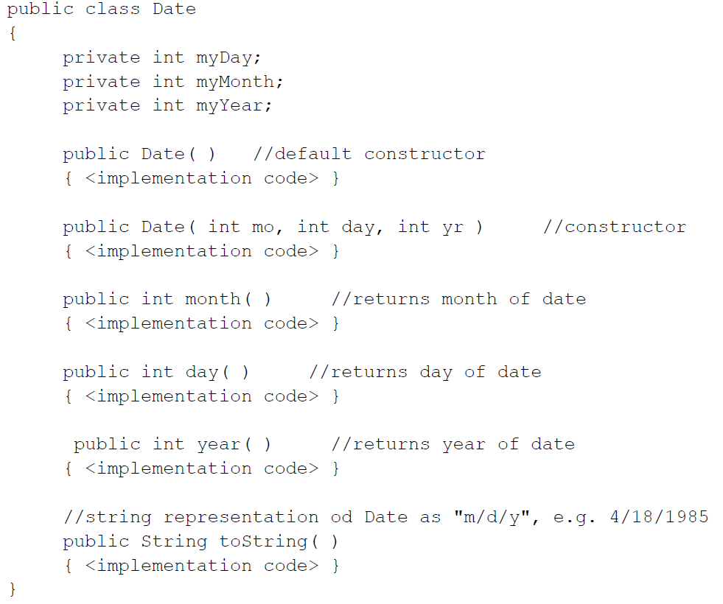
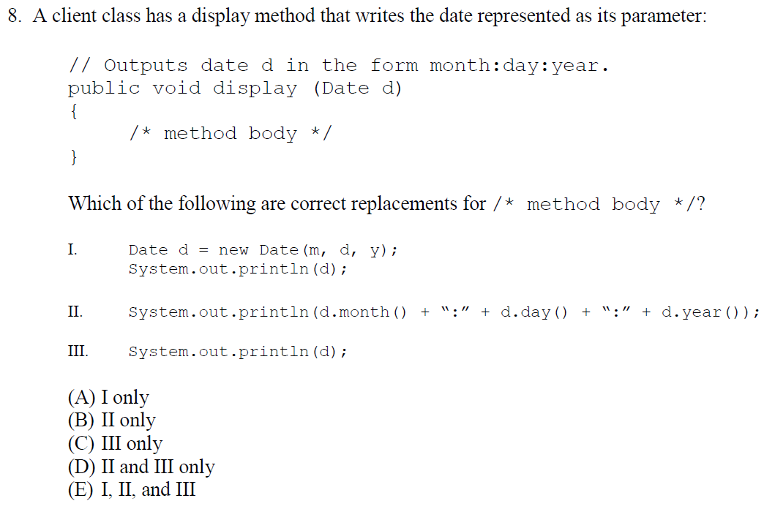

Slide 10
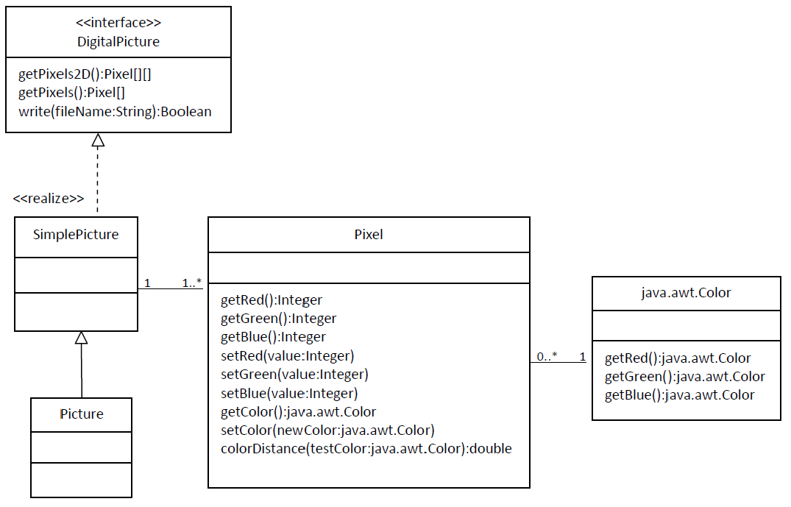
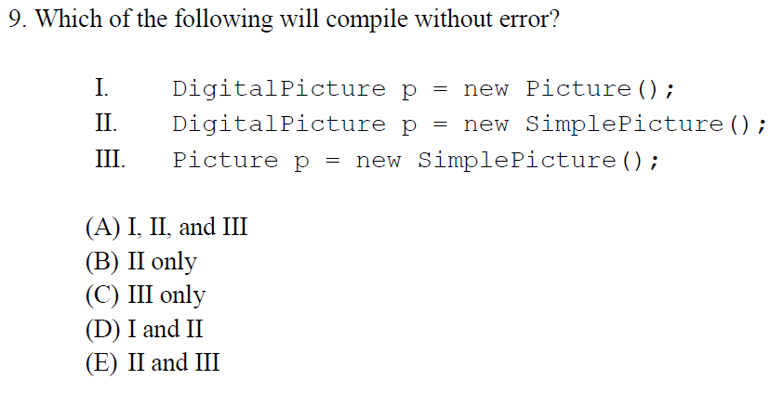

Slide 11
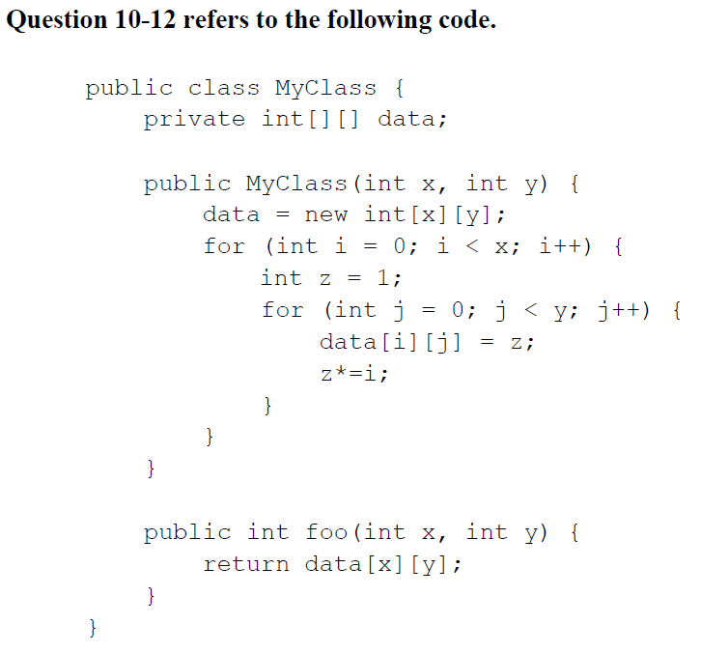
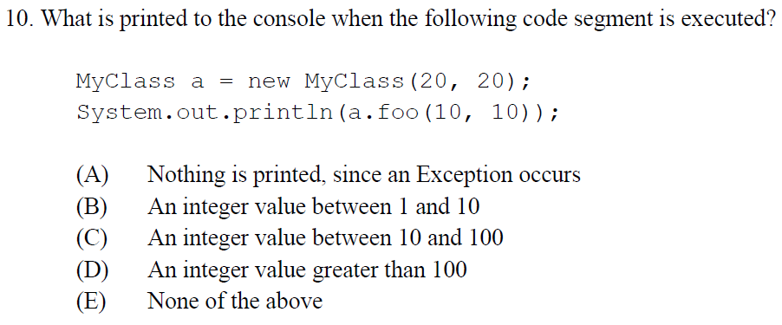

Slide 12
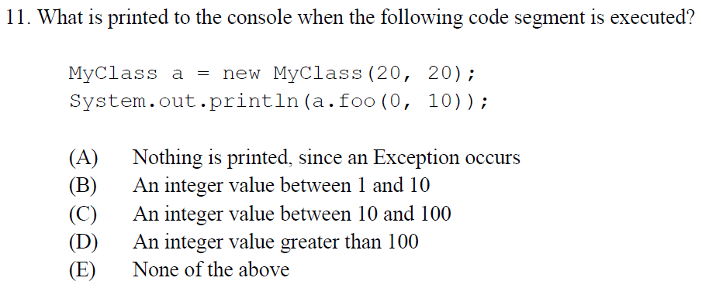

Slide 13
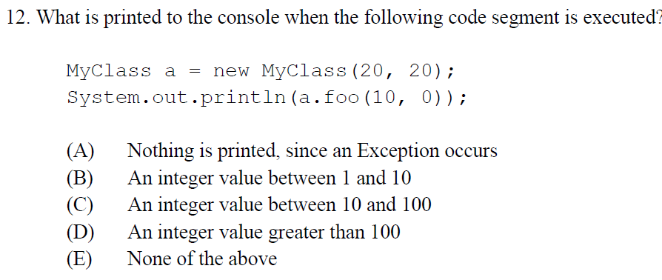

Slide 14
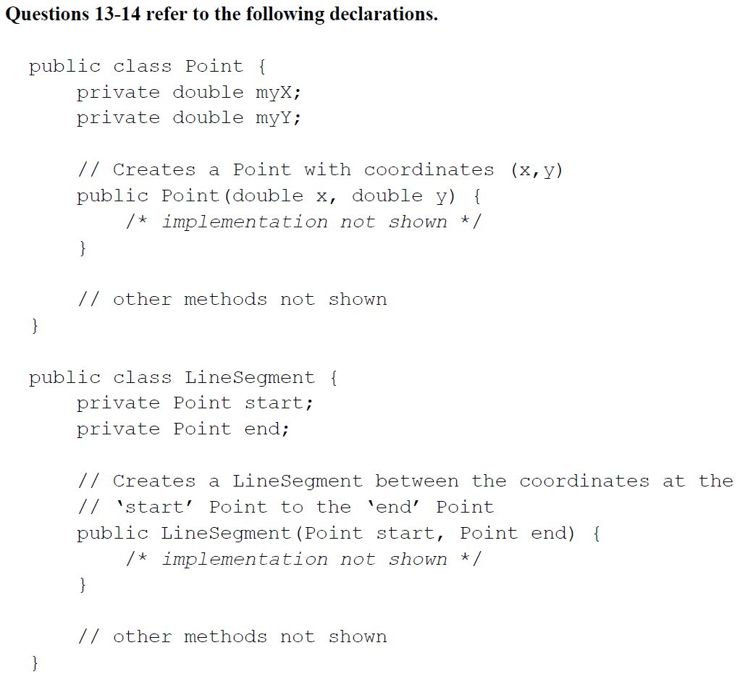
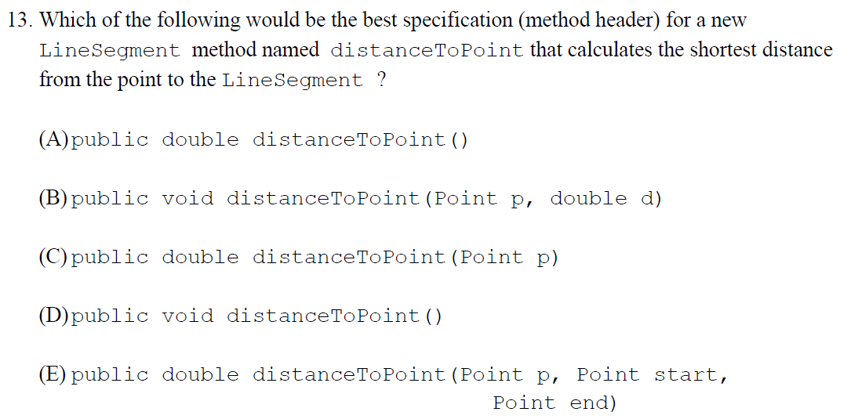

Slide 15
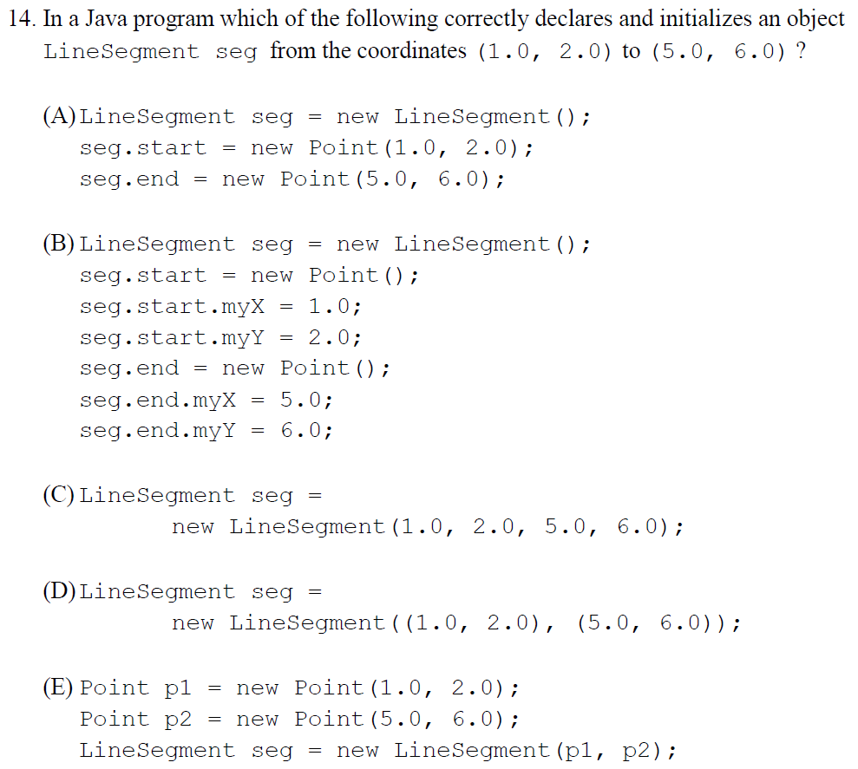

Slide 16
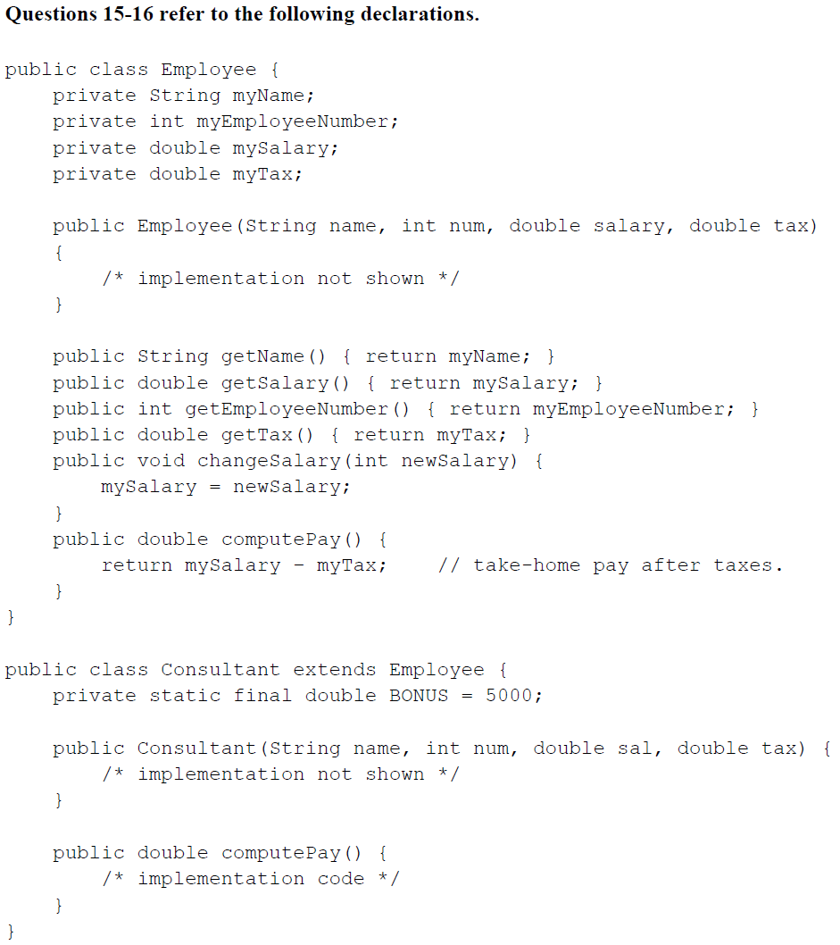
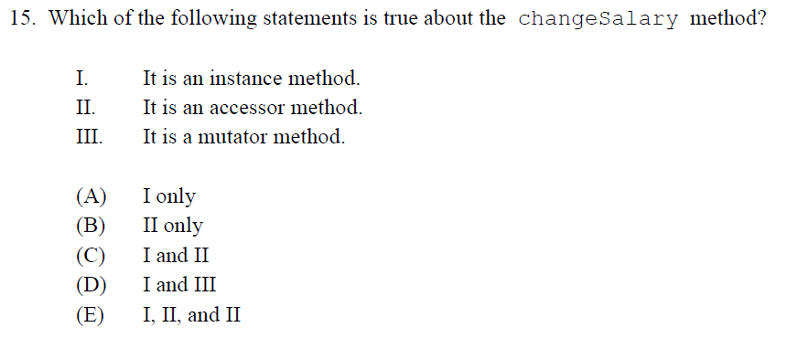

Slide 17
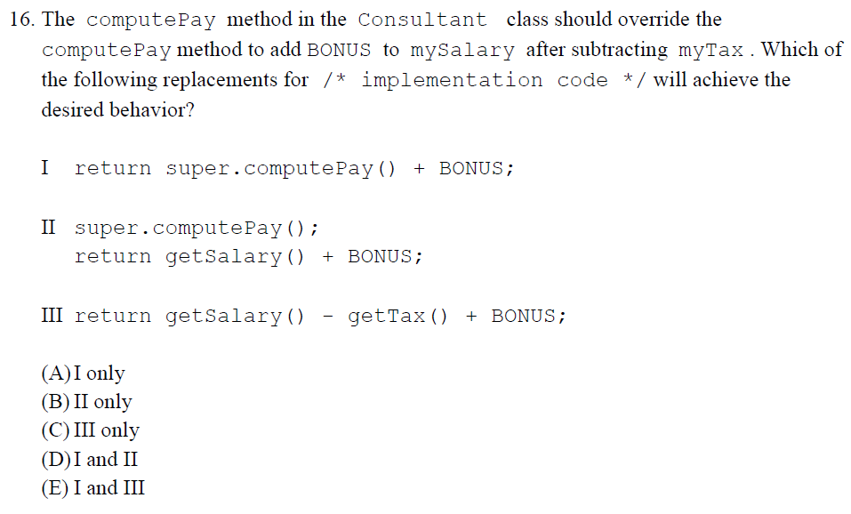

Slide 18
Homework
Read HW 9.1
Correct any incorrect test answers by re-answering on a separate sheet of paper:
To get back credit, you must justify your new answers.
Staple new answer sheet to the old test and return it tomorrow.

Slide 19
Inheritance Basics
[ 6.01 ] [ Today’s Date ] [ Instructor Name ]

Slide 20
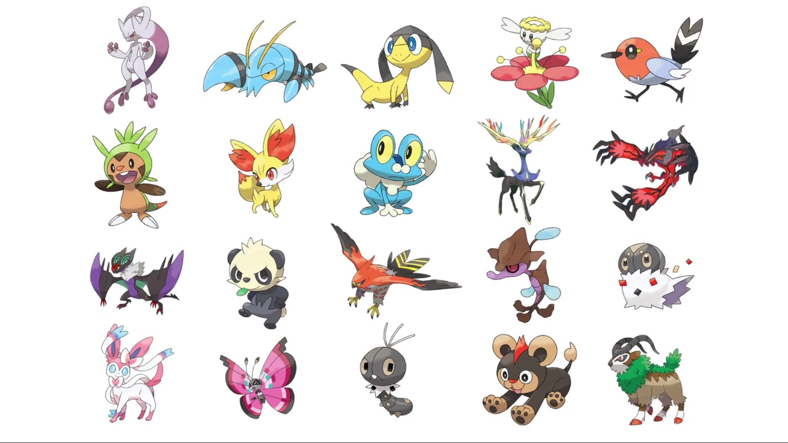

Slide 21
What do all Pokémon have in common?

Slide 22
We need to create a superclass:
Every Pokemon is an instance.
Vocabulary:
Inheritance Hierarchy
Inheritance
Superclass
Subclass, or Child Class

Slide 23
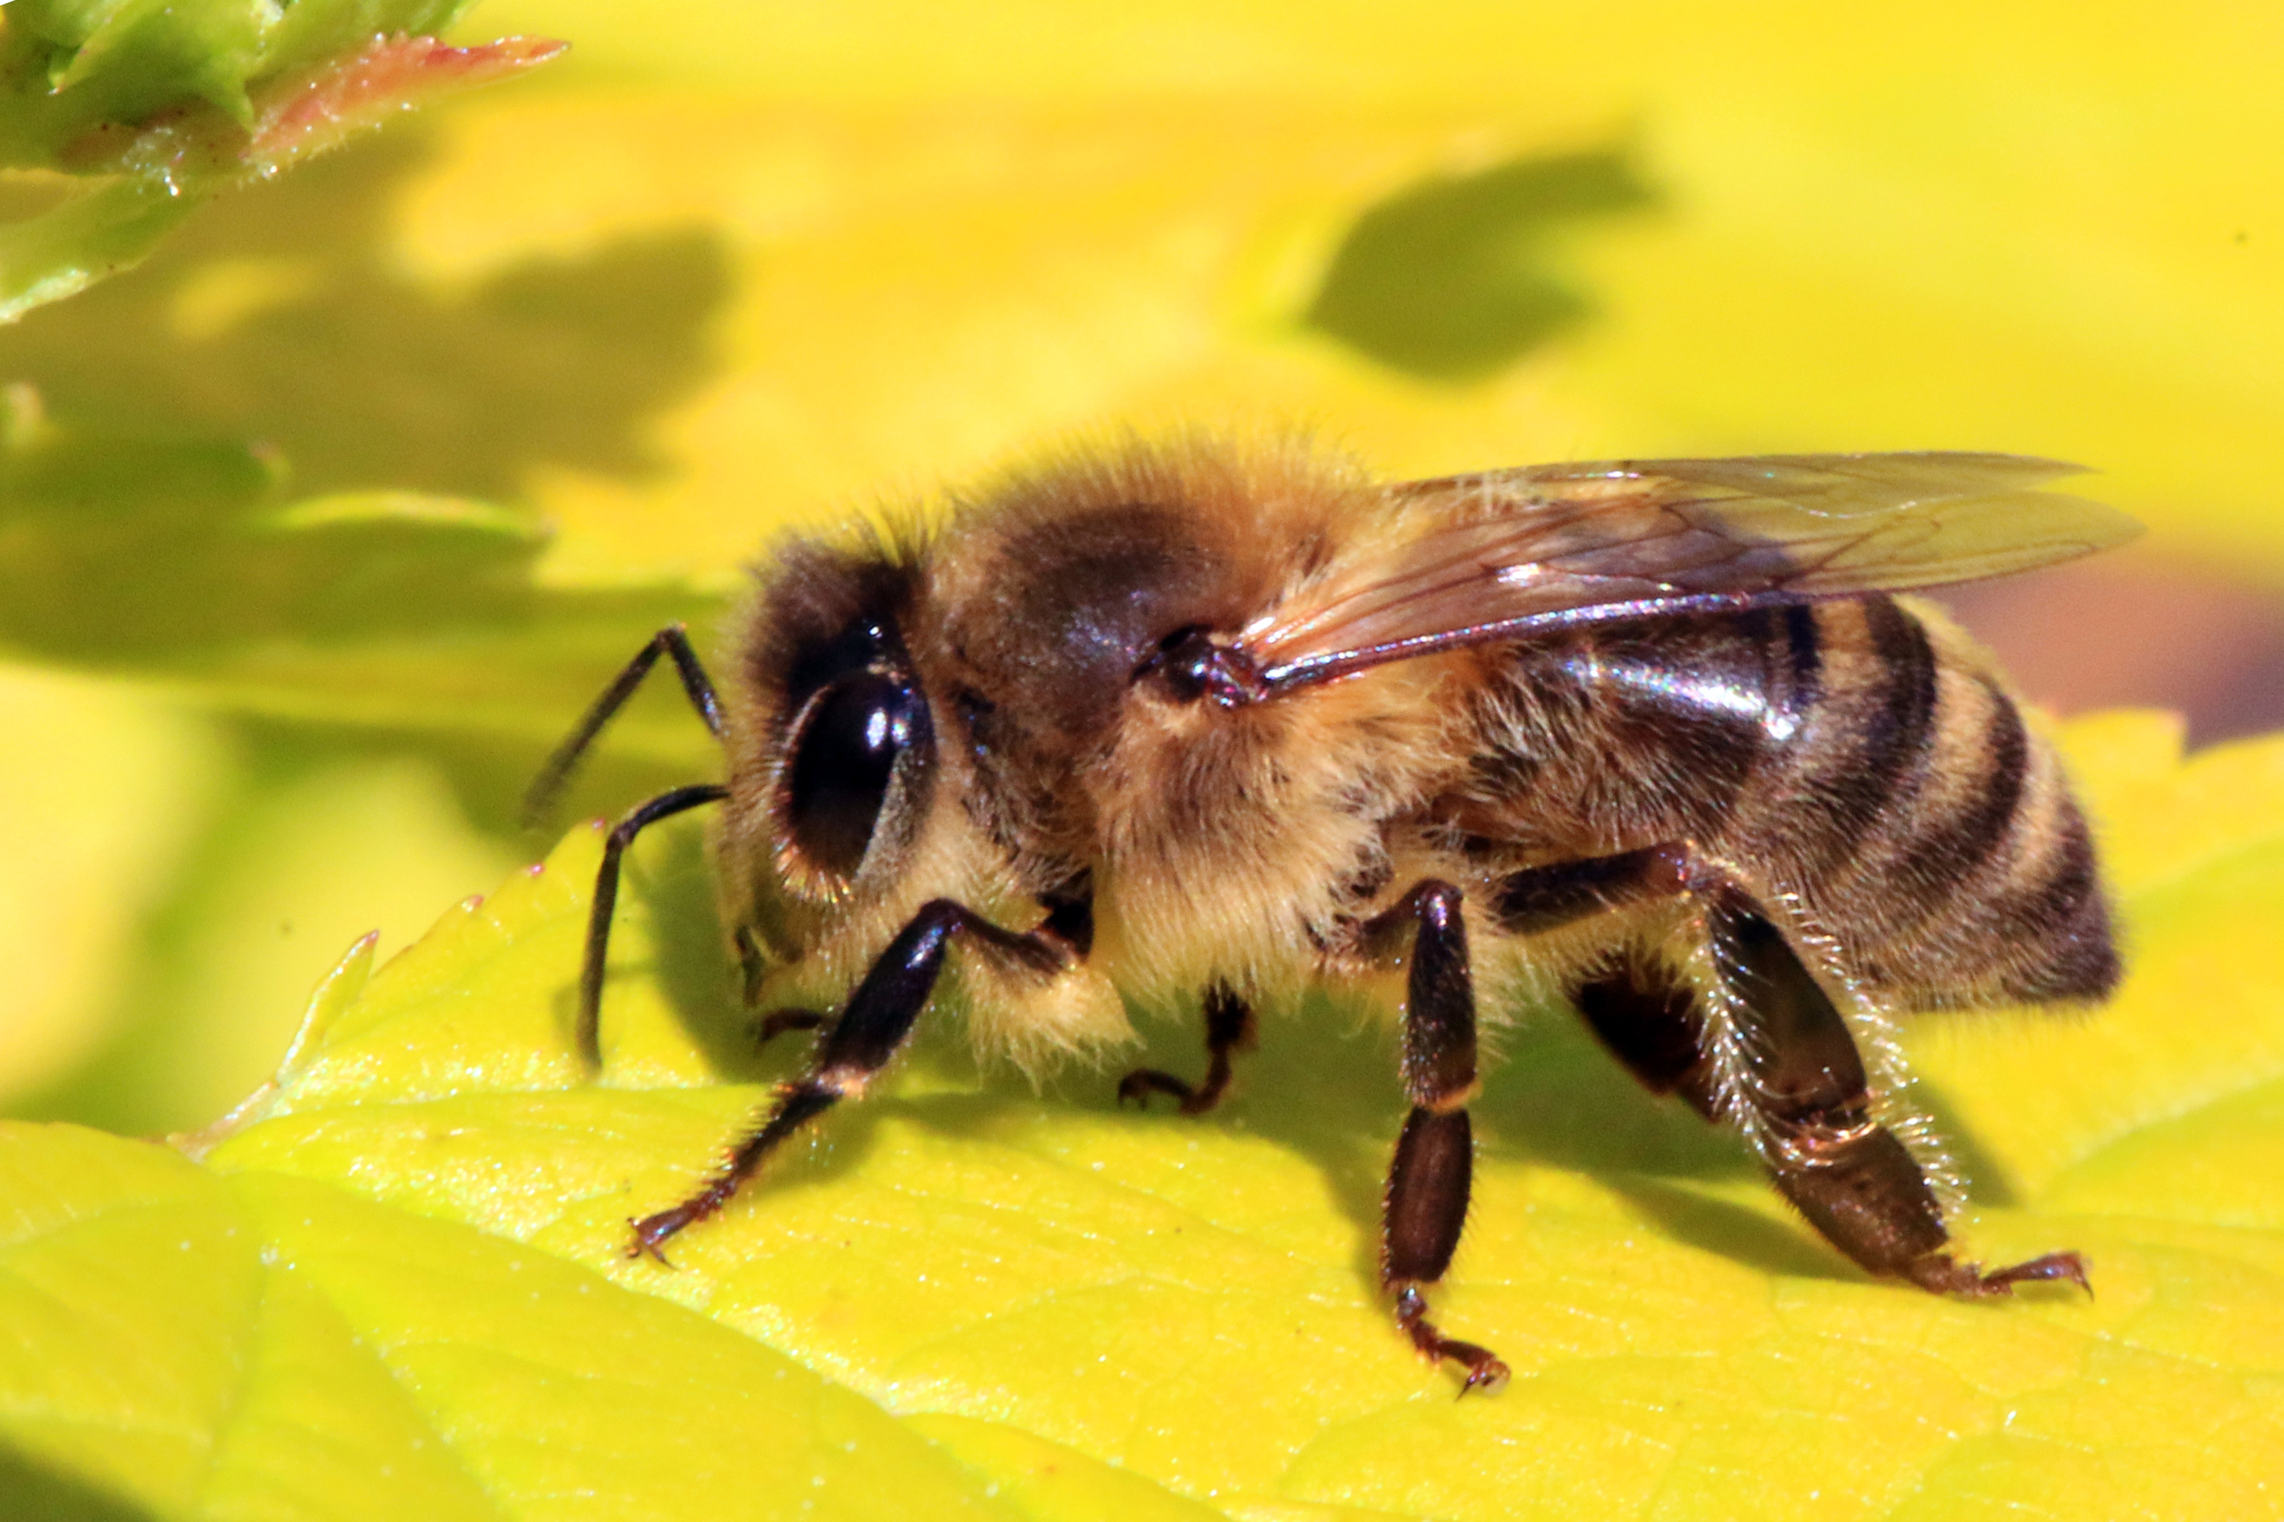
Bees!
What do bees do?
Notes:
https://www.youtube.com/watch?v=K3oMN1a_pdg

Slide 24

Create a Bee class:
Each Bee is an instance.
What methods should the Bee class have?
What attributes?

Slide 25
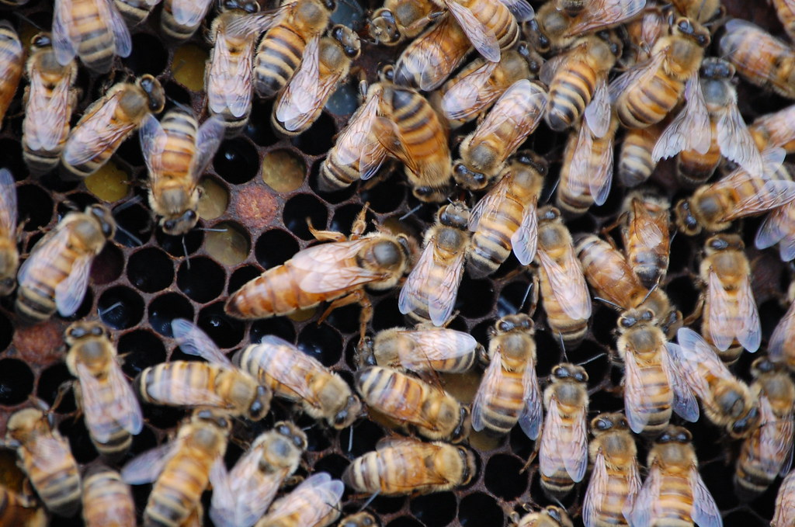
Create Bee Subclasses
What are the different types of Bees in a hive?
What do the types have in common? What will they inherit from the Bee superclass?
How will the subclasses differ from the superclass?

Slide 26
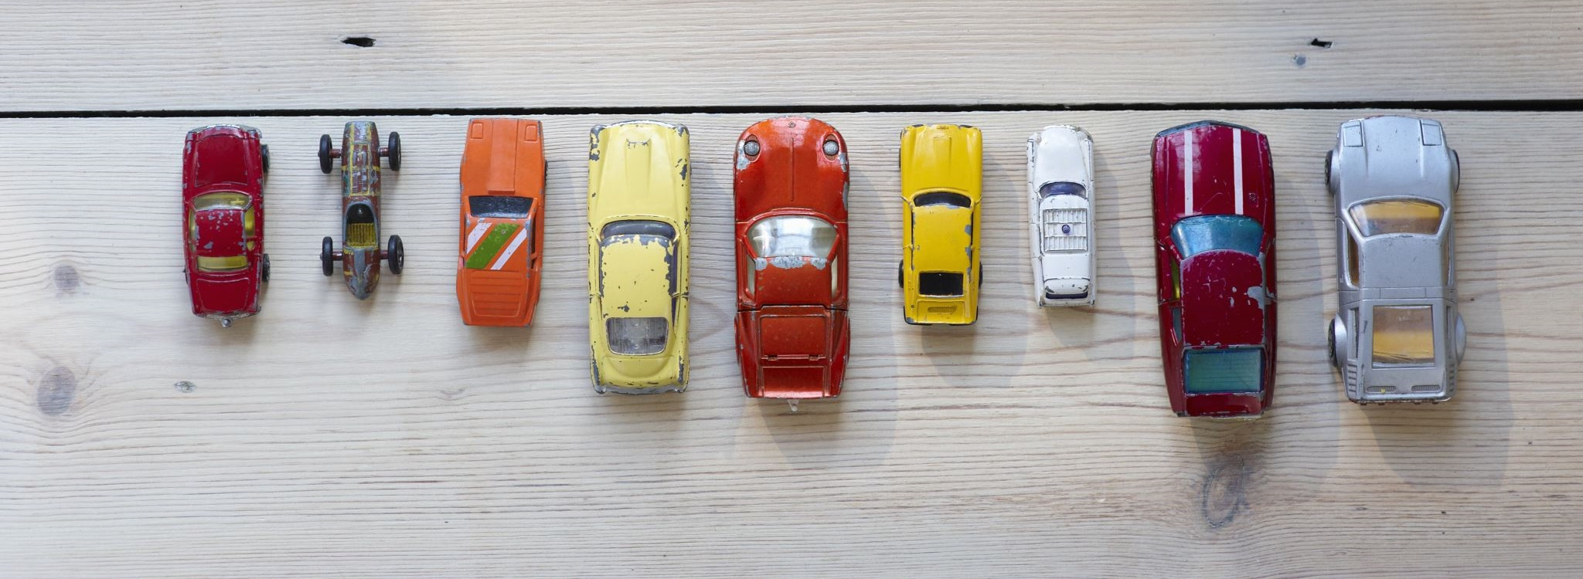
Vehicle Class
class Vehicle {
private int xCord;
private int yCord;
private double fuelGallons;
private double maxFuel;
private double mileFuelRatio;
public Vehicle(int xStart, int yStart, double fuelGallons, double maxFuel, double milePerGallon){
this.xCord = xStart;
this.yCord = yStart;
this.fuelGallons = fuelGallons;
this.maxFuel = maxFuel;
this.milePerGallon = milePerGallon;
}
public void move(int dx, int dy){
// if there is enough fuel, move dx and dy feet.
double distance = Math.sqrt(Math.pow(dx, 2) + Math.pow(dy, 2));
double fuelUsed = distance / (5280 * mileFuelRatio);
if (fuelGallons - fuelUsed > 0){
xCord += dx;
yCord += dy;
fuelGallons -= fuelUsed;
}
else{
System.out.println("Not enough fuel.");
}
}
public void refuel(double fuel){
fuelGallons += fuel;
if (fuelGallons > maxFuel){
fuelGallons = maxFuel;
}
}
}
Notes:
Refer to Vehicle.java file for full code.

Slide 27

Subclasses
class Car extends Vehicle {
public Car(int xStart, int yStart){
super(xStart, yStart, 15, 15, 20);
}
}
class Motorcycle extends Vehicle {
public Motorcycle(int xStart, int yStart){
super(xStart, yStart, 5, 5, 50);
}
}
class Semi extends Vehicle {
public Semi(int xStart, int yStart){
super(xStart, yStart, 130, 130, 6.5);
}
}

Slide 28
What fields would a specialized subclass have that a superclass wouldn’t?

Slide 29
Airplane Class
class Airplane extends Vehicle {
private int zCord;
private boolean landingGear;
public void liftoff(int dx, int dy, int dz){
if (zCord > 0){
System.out.println("We're already flying!");
return;
}
// if there is enough fuel, move dx, dy, and dz feet.
double distance = Math.sqrt(Math.pow(dx, 2) + Math.pow(dy, 2) + Math.pow(dz, 2));
double fuelUsed = distance / (5280 * mileFuelRatio);
if (fuelGallons - fuelUsed > 0){
xCord += dx;
yCord += dy;
zCord += dz;
fuelGallons -= fuelUsed;
landingGear = false;
}
else{
System.out.println("Not enough fuel.");
}
}

Slide 30
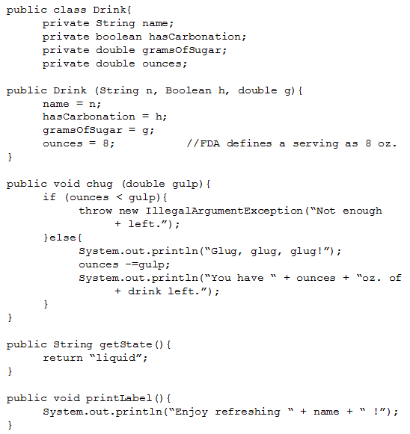


Slide 31
SugarFreeDrink class:
public class SugarFreeDrink extends Drink {
private boolean hasSweetener;
private double caffeineContent;

Slide 32
SugarFreeDrink class:
public SugarFreeDrink(String name, Boolean hasCarbonation, boolean h, double c) {
super(name, hasCarbonation, 0.0); //Superclass’
hasSweetener = h;
caffieneContent = c;
}

Slide 33
SugarFreeDrink methods:
public void printWarningLabel() {
if(hasSweetener) {
System.out.println(“This drink is not safe for
+ Phenylketonurics.”);
} else {
System.out.println(“This drink contains no
+ artificial sweeteners.”);
}
}

Slide 34
Worksheet 6.1: Posters

Slide 35
Quiz 6.1

Slide 36
Homework
Read HW 9.2 up to “DividendStock Behavior”
Collect images that represent instances of the classes created for in-class poster project.

Slide 37
Overriding Methods & Accessing Inherited Code
[ 6.02 ] [ Today’s Date ] [ Instructor Name ]

Slide 38
Why is it useful to inherit methods?

Slide 39
When might we not want inherited methods?

Slide 40
Inherited methods can be different
Subclass FootballPlayer may have a different throwing method than superclass Athlete.
Subclass SoccerPlayer may even ignore the method (design choice, soccer players cannot throw!)

Slide 41
Submarine Class
class Submarine extends Vehicle {
private int zCord;
public void move(int dx, int dy){
// Nuclear subs don't really run out of fuel so no need to check.
this.xCord += dx;
this.yCord += dy;
}
public void move(int dx, int dy, int dz){
this.xCord += dx;
this.yCord += dy;
this.zCord += dz;
}
}

Slide 42
HybridCar Class
class HybridCar extends Car {
private double batteryLife;
private double batteryPerMile;
public void move(int dx, int dy){
// If the battery is charged use it, otherwise use the fuel.
double distance = Math.sqrt(Math.pow(dx, 2) + Math.pow(dy, 2));
double batteryUsed = distance / (5280 * batteryPerMile);
if (batteryLife - batteryUsed > 0){
batteryLife -= batteryUsed;
xCord += dx;
yCord += dy;
}
else{
super.move(dx, dy);
}
}
}

Slide 43
Overloading vs Overriding

Slide 44
Overriding: chug
// SugarFreeDrink
public void chug(double gulp) {
System.out.println(“Yuck, this tastes terrible!”)
}

Slide 45
Overriding: chug
public void chug(double gulp) {
if (ounces < gulp) {
throw new IllegalArgumentException();
} else {
System.out.println(“Glug, glug, glug!”);
ounces -= gulp;
System.out.println(“You have “ + ounces + “oz.
+ of drink left.”);
}
}

Slide 46
Overriding: chug
//new chug method, SugarFreeDrink
public void chug(double gulp) {
System.out.println(“Yuck, this tasted terrible!”);
super.chug(gulp);
}

Slide 47
How do we access encapsulated information?

Slide 48
Get and Set Methods
public int getX(){
return xCord;
}
public int getY(){
return yCord;
}
public double getFuel(){
return fuelGallons;
}

Slide 49
get methods:
public double getName() { //written in superclass
return name;
}
public void advertising() {
System.out.println(“Avoid the extra calories by drinking delicious “ + getName() + “every day!!”);
}

Slide 50
Worksheet

Slide 51
Homework
Read HW 9.2 up to “The Object Class”

Slide 52
Interacting with the Object Superclass
[ 6.03 ] [ Today’s Date ] [ Instructor Name ]

Slide 53
The Object Superclass
All classes are subclasses of the Object class
The Object class is located in java.lang package
This means all objects inherit some methods:
toString() //only ones on AP
equals()

Slide 54
Who remembers what toString() does?

Slide 55
Why can’t we just use == to test for equality?

Slide 56
The standard == operator:
String z = “z”; a == b
Evaluates to false because a and b
String a = z + z; refer to different strings.
String b = “zz”; c == b
Evaluates to true because c and b
String c = b; refer to the same string.

Slide 57
The String equals methods
a.equals(b)
/* evaluates to true because the content of a and b are the same */
c.equals(b)
/* evaluates to true because c and b refer to the same string */

Slide 58
Overriding the equals method:
public boolean equals(Object o){
Drink other = (Drink) o;
return name.equal(other.name) && ounces == other.ounces;
}
What does this let us compare?
What are some examples of where this can be useful?
Notes:
A good place to touch on boolean zen.

Slide 59
Static vs Dynamic Binding
Static Binding
At compile time, methods in or inherited by the declared type determine the correctness of a non-static method call
Dynamic Binding
At run-time, the method in the actual object type is executed for a non-static method call
Notes:
A good place to touch on boolean zen.

Slide 60
Practice Problems
Self-Check 9.3: subclassSyntax
Self-Check 9.10: inheritanceVariableSyntaxCarTruck
Self-Check 9.9: CarTruck2
Exercise 9.4: MonsterTruck

Slide 61
Worksheet

Slide 62
Homework
Read HW 9.3 up to “Interpreting Inheritance Code”

Slide 63
Polymorphism
[ 6.04 ] [ Today’s Date ] [ Instructor Name ]

Slide 64
Review: subclass vs. superclass
subclass “extends” superclass
superclass: More general, less capability
subclass: More specific, more capability
Think of a subclass as being “better” than a superclass.

Slide 65
Variables and Objects
Variable can hold objects of its type or “better” (subclass is “better”!)
Same goes for parameters and fields.
If: public class Lion extends Animal { … }
Then: Animal simba = new Animal();
Or: Animal simba = new Lion();
Notes:
A variable (reference) of type Animal can point to an object of type Lion because all Lions are Animals.

Slide 66
References
The reverse is NOT true!
If: public class Lion extends Animal { … }
Then: Lion simba = new Lion();
NOT: Lion simba = new Animal(); (Lions > Animals)
Notes:
A Lion variable can certainly point to a Lion object.
A Lion variable (reference) can't point at an Animal object because Animal is the superclass, Lion is the subclass. An Animal object might be a Lion, but it also could be many other Animals so such a reference is not OK.

Slide 67
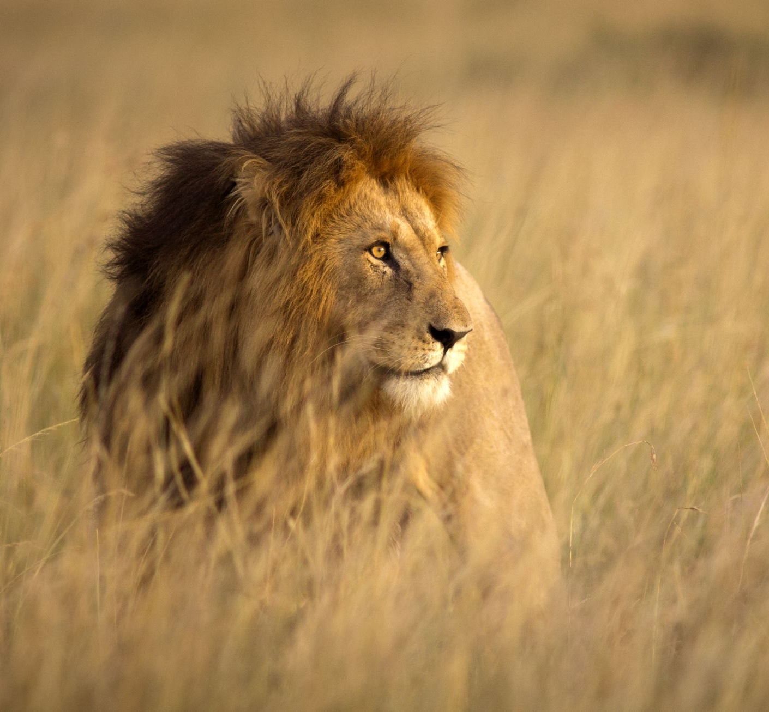
Once again:
IF a variable points to an object…
THEN the object must be of the same type as the variable or more specific
That means that the object can be a subtype of the variable type!
Lion is a subtype of Animal

Slide 68
Polymorphism
The ability to use the same code with different types of objects and behave differently with each.
Animal simba = new Lion();
The variable is of type Animal. The object is of type Lion. So will simba exhibit the behaviors of an Animal or a Lion?
Notes:
Define:
Poly = many
Morph = forms / shapes
Polymorphism is a difficult topic to understand, it’s worthwhile to spend extra time here with your students.

Slide 69
Polymorphism
public class Lion extends Animal { … }
Animal simba = new Lion();
System.out.println(simba.say());
Output: “Rawr!!”
Notes:
If a method is defined in the superclass and then overridden in the subclass, the object that the
Note that if say() is a method that belongs to Animal but is overridden in Lion, a call to say() is in fact a call to the method defined by Lion.

Slide 70
Understanding Polymorphic Method Calls
Given the following classes, what would be the output of the following client code?
MusicalInstrument[] insts = {
new MusicalInstrument(), new ElectricKeyboard(),
new Guitar(), new ElectricGuitar() };
for (int i = 0; i < insts.length; i++) {
System.out.println(insts[i]); // call to toString()
insts [i].pickSound();
insts [i].playNote();
System.out.println();
}
Notes:
Note that ElectricKeyboard, Guitar, and ElectricGuitar are all subclasses of the superclass MusicalInstrument.
Additionally, ElectricGuitar is a subclass of Guitar
Within the for loop, which versions of toString(), pickSound(), and playNote() are being called?

Slide 71
Step 1: Class Diagram
Add classes from top (superclass)
to bottom (subclass).
MusicalInstrument
ElectricKeyboard
Guitar
ElectricGuitar

Slide 72
Step 2: Finding output with a table:
Italics inherited but not overridden:
Method | Musical Instrument | Electric Keyboard | Guitar | Electric Guitar
pickSound() | Only one sound! | Press sound button | Only one sound! | Hit the fuzz box!
playNote() | Playing | Playing | Strumming | Strumming
toString() | Musical Instrument | Musical Instrument | Guitar | Guitar
Notes:
The methods

Slide 73
Step 3: Write It Up
MusicalInstrument[] insts = {
new MusicalInstrument(), new ElectricKeyboard(),
new Guitar(), new ElectricGuitar() };
for (int i = 0; i < insts.length; i++) {
System.out.println(insts[i]);
insts [i].pickSound();
insts [i].playNote();
System.out.println();
}

Slide 74

Answer:
MusicalInstrument
Only one sound!
Playing
MusicalInstrument
Press sound button
Playing
Guitar
Only one sound!
Strumming
Guitar
Hit the fuzz box!
Strumming
Notes:
Useing the Step 1 hierarchy graph and the Step 2 Output table:
Walk through each Musical Instrument printed through the loop.
Have students explain how each statement produced the given out in the 3 loop lines:
System.out.println(insts[i]);
insts [i].pickSound();
insts [i].playNote();

Slide 75
Worksheet

Slide 76
Homework
Read BJP 9.4 section “Is-a Versus Has-a Relationships”
Complete self-check questions #18 – 20

Slide 77
Has-a Relationships
[ 6.05 ] [ Today’s Date ] [ Instructor Name ]

Slide 78
Relationship between a: Animal, Carnivore, Tiger, and Donkey
Animal
Carnivore
Tiger
Donkey
This is an Is-a Relationship
Notes:
Note that this inheritance structure makes sense—A tiger is-a carnivore, a carnivore is-a(n) animal, a donkey is-a animal.

Slide 79
Is-a relationships for: ZooMember ZooFacility
ZooMember
Zookeeper
Trainer
CustomerService
ZooFacility
GiftShop
Bathroom
Cafeteria

Slide 80
So how would we model a zoo? Zoo
Has-a describes the relationship between a class that is client code of another class.
You should use a has-a relationship when you can’t substitute one class for another.
In this case, a Zoo is not an Animal, ZooMember or ZooFacility, rather a Zoo has all of these components.
Zoo
Animal
ZooMember
ZooFacility

Slide 81
Has-a Relationships
How would you design a Zoo?
A Zoo has many parts:
Animals, ZooMember, ZooFacility
You need many instances of each of these classes to have an effective Zoo.

Slide 82
Declaring a Has-a Relationship
public class Zoo{
private Animal[] animals;
private ZooMember[] zooMembers;
private ZooFacility[] zooFacilities;
…
}
We create fields that refer to other classes to create a has-a relationship.

Slide 83
Constructors
If no constructor is specified, the compiler will add a no-argument constructor.
A no-argument constructor has no parameters, for example public Zoo().
If a subclass has no call to a superclass constructor using super as the first line in a subclass constructor, then the compiler will automatically add a super() call as the first line in a constructor.
provide no-argument constructors in parent classes
or be sure to use an explicit call to super() as the first line in the constructors of subclasses.
Regardless of whether the superclass constructor is called implicitly or explicitly, the process of calling superclass constructors continues until the Object constructor is called since every class inherits from the Object class.
Notes:
Does this slide even belong here?

Slide 84
Worksheet 6.5: Trio

Slide 85
Homework
Read BJP 9.5

Slide 86
Interfaces (Optional)
[ 6.06 ] [ Today’s Date ] [ Instructor Name ]

Slide 87
Has-A Review
public class Vehicle{}
public class Speed{}
public class Van extends Vehicle {
private Speed sp;
}
Class Van Has-A Speed.
By having a separate class for Speed it possible to reuse the Speed class in multiple applications

Slide 88
What are some limitations to inheritance?
Can we inherit code from more than one superclass?
Can we have an is-a relationship or polymorphism without giving the subclass access to our code?

Slide 89
Interfaces
Offer a means to share a common supertype without sharing the code.
An interface consists of a set of method declarations without bodies.
A promise of behavior; methods are declared but not defined.
The method will be defined in the subclass.
An error will be thrown if you don’t define the method.

Slide 90
Interface in practice:
Pork
Bacon
Lard
Salty
Aromatic
Greasy
Edible

Slide 91
Declaring Interfaces
public interface Salty{
double sodiumContent(); ←this is a promise to implement the sodiumContent
} in the class that implements the Salty interface.
public interface Aromatic{
String describeAroma(); ← Notice the lack of “public”! Public is assumed.
}
public interface Greasy{
double amountOfGreaseInMg(); ←point out that interfaces look just like classes
} but without fields or method bodies
public interface Edible{
double calories();
}

Slide 92
Implementing Interfaces
public class Bacon extends Pork implements Salty, Aromatic, Greasy, Edible {
private double amountInKg;
public Bacon(double amount){
amountInKg = amount;
}
public double calories(){
return amountInKg * CALORIES_PER_KG_OF_BACON;
}
}

Slide 93
Class Activity
[Delete the activities you are not using]
Subclasses: Red, Orange, Yellow, Green, Blue
Interface: color
Sample Methods: double wavelengthInNm, Boolean isPrimaryColor
Subclasses: Wood, Brick, Adobe, Stone, Canvas
Interface: buildingMaterial
Sample Methods: String movableHousing, double costPerLb
Subclasses: Boeing 747, Pheasant, PaperAirplane, Cannonball
Interface: flies
Sample Methods: getMaximumAltitude, getRange, getSpeed

Slide 94
Challenge
Students should define classes to implement as many combinations of interfaces as possible.
Students must include at least 1 method for each interface.
Each class has to implement the interface methods and include a constructor.

Slide 95
Homework
Read HW 9.6
Summarize notes in notebook for tomorrow’s notebook check
For extra credit:
Generate your own class hierarchy that demonstrates the same concepts illustrated by the Financial Class Hierarchy outlines in the book. The extra credit project is due [in one week].

Slide 96
Programming Project
[ 6.07 ] [ Today’s Date ] [ Instructor Name ]

Slide 97
[Slides reserved for Programming Project Review]
Edit this slide deck to go over questions that your class has during the programming project days.

Slide 98
Finding and Fixing Errors
[ 6.08 ] [ Today’s Date ] [ Instructor Name ]
Notes:
This unit is mostly done on the board. Feel free to edit this slide deck as you see fit!

Slide 99
Today’s plan:
Error check and resubmit all chapter 9 assignments.
Study for the test by:
Reviewing all the blue, self-check pages at the end of Chapter 9.
Re-reading sections as needed to complete the self-check problems.

Slide 100
Homework Regrade/Resubmit
You all can get full credit on your homework grades by correcting them now, in class.
Use your error checking algorithm, and if you need help just ask!

Slide 101
Homework
Begin reviewing chapter 9 for the Unit 6 Test.

Slide 102
Review
[ 6.09 ] [ Today’s Date ] [ Instructor Name ]

Slide 103
What’s on the test?

Slide 104
Practice Test

Slide 105
Review Topics
Make a list of review topics that you feel you need to go over for the test tomorrow.
For each topic, follow up by reviewing the textbook, self-check problems, and the appropriate Practice problems.

Slide 106
Good Luck!

